Slide 1
Azure Migration
BRK3055
Name
Title

Slide 2
What’s Driving Migrations?
Software and hardware refresh
Security threats
Urgent capacity needs
Compliance
Quickly integrate acquisitions
Application innovation
Software end of support
Datacenter contracts expiry
Migration triggers

Slide 3
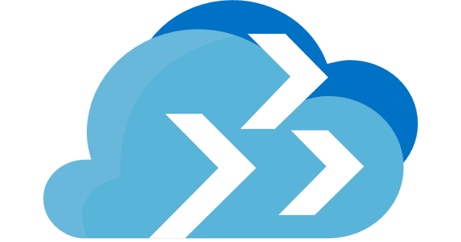





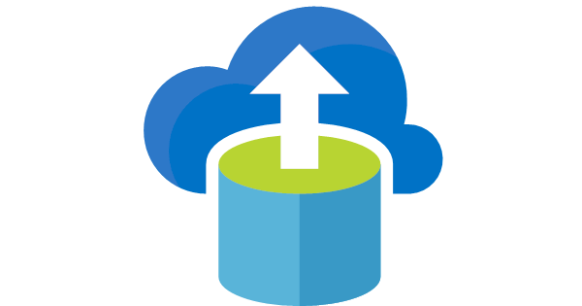



Migrate to Azure
. Today!
Azure Migrate to assess Windows and Linux VMs on VMware
Java and Tomcat support in Azure App Service
Azure Database for PostgreSQL, MySQL, and MariaDB
Azure Site Recovery for Windows and Linux migration
Windows / Linux containers on Azure App Service, Kubernetes on Azure
Azure SQL Database Managed Instance
Azure Database Migration Service for SQL Server and My/ Postgre/No-SQL migration
Red Hat Enterprise Linux & Red Hat OpenShift
Cassandra and Mongo DB support in Azure Cosmos DB

Slide 4
Azure Migration Experience: Unified and Extensible
Migrate*
Rehost
lift-and-shift
Optimize
Refactor
Assess
Secure & Manage
Rearchitect
Rebuild
*These migration strategies are adopted from Gartner research. Gartner also calls out a 5th strategy called “Replace” with SaaS

Slide 5


















Choice of Tools for Every Stage
Assess
Secure & Manage
Migrate
Optimize
Azure Migrate
Azure Site Recovery
Azure Cost Management
Azure Security and Management Services
Data Migration Assistant
Azure Database Migration Service
SQL Server Migration Assistant
Azure Data Box

Slide 6


Azure Migrate for Discovery and Assessment
Azure Migrate for Discovery and Assessment
What does it do?
Easily discover on-premises VMs and applications, including application dependencies
Insightful workload assessments:
Azure suitability analysis
Right-sized Azure resources based on utilization history
Estimated cost in Azure
Migration risks and recommended tools
Support for VMware and ^{NEW}Hyper-V
Azure

Slide 7





How Azure Migrate Works
Raw metadata
Processed metadata
Appliance
HTTPS, 443
Assessment
Azure Migrate Service
2. Start discovery
3. Create assessment
Raw metadata
1. Download and configure appliance
Customer
Documentation: http://aka.ms/azuremigrate/documentation
Videos: https://aka.ms/migrate/video

Slide 8
Recent Enhancements
Sizing | Target location Performance-based sizing ^{NEW} Continuous discovery and profiling ^{NEW} As on-premises sizing ^{NEW} Option to specify VM series ^{NEW} Option to specify storage type for Single VM SLA ^{NEW} Confidence rating
Cost estimation | Azure Hybrid Benefit Azure Offers Custom Discount Currency ^{NEW} Reserved Instances ^{NEW} VM uptime
Migration target locations | Azure commercial regions ^{NEW} Azure Government, Germany and China
Azure platform support | Managed Disk Large disk support ^{NEW} Windows Server 2008 (32 & 64-bit support)
Support Matrix
https://aka.ms/migrate/targetregions

Slide 9
Azure Site Recovery for Server Migration
The Azure Site Recovery Advantage
Effortless migration of VMs and apps to Azure
Zero application data loss during migration
Near-zero application downtime during migration
Broad coverage for hypervisors, applications, operating systems, and Azure features
No-impact application testing in Azure
Free usage during migration
Azure

Slide 10






How Hyper-V Migration Works
443 (HTTPS)
Microsoft Azure
Data Channel
Public Internet or ExpressRoute with Public Peering
Source: Hyper-V
Microsoft Azure Recovery Services Agent
Replicates data to Azure
Documentation: https://aka.ms/asr_hyperv
Videos: https://aka.ms/asr_videos

Slide 11




How VMware Migration Works
Config Server
Process Server
443 (HTTPS)
9443 (HTTPS)
443 (HTTPS)
Microsoft Azure
Data Channel
Public Internet or ExpressRoute with Public Peering
Source: VMware, AWS, Physical Servers
Process Server
Used for caching, compression, and encryption
Configuration Server
Used for centralized management
Mobility Service Captures all data writes from memory
Documentation: http://aka.ms/asr_vmware
Videos: https://aka.ms/asr_videos

Slide 12
Comprehensive Coverage for VMware
vCenter Server and vSphere support | 6.5, 6.0, ^{NEW}6.7, 5.5
Windows Guest OS support | Windows Server 2016 Windows Server 2012 R2 Windows Server 2012 Windows Server 2008 R2 ^{NEW} Windows Server 2008 (32-bit and 64-bit)
Linux Guest OS support | RHEL 5.*, 6.*, ^{NEW}6.10 and 7.*,^{NEW} 7.5 Cent OS 5.*, 6.*, ^{NEW}6.10 and 7.*,^{NEW} 7.5 Ubuntu 14.04 and 16.04 LTS ^{NEW} SUSE Enterprise Server 12 SP1, SP2, SP3 SUSE Enterprise Server 11 SP3, SP4, 12 SPI OEL 6.4 and 6.5 Debian 7 and 8 support
Azure platform support | Managed Disk Encrypted Storage Azure Hybrid Benefit for Windows Server
Support Matrix
https://aka.ms/asr_supportmatrix
NOTE: Hyper-V migration with Azure Site Recovery supports every Windows and Linux OS that is endorsed to run on the Azure Compute platform

Slide 13



Database Migration Service for Database Migration
Seamless, end-to-end solution for moving databases to the cloud
Near-zero downtime as you migrate your business-critical apps
Migrate at scale from multiple sources to your target database
Azure
On-premises
Competitive
SQL
My
Internet
VPN or
ExpressRoute
SQL Server
2005 - 2017
My
Database Migration Service
SQL
SQL
Assessment tools
SSMA & DMA

Slide 14
Database Migration Service Announcements
Source | Target | Release Status
SQL Server | Azure SQL Database Managed Instance | ^{NEW} Generally Available
MySQL | Azure Database for MySQL | ^{NEW} Preview
PostgreSQL | Azure Database for PostgreSQL | ^{NEW} Preview
MongoDB | Cosmos DB | ^{NEW} Limited preview
Support Matrix
https://aka.ms/dms_supportmatrix

Slide 15
Discover and Assess VMware and Hyper-V Environments
Azure Migrate

Slide 16
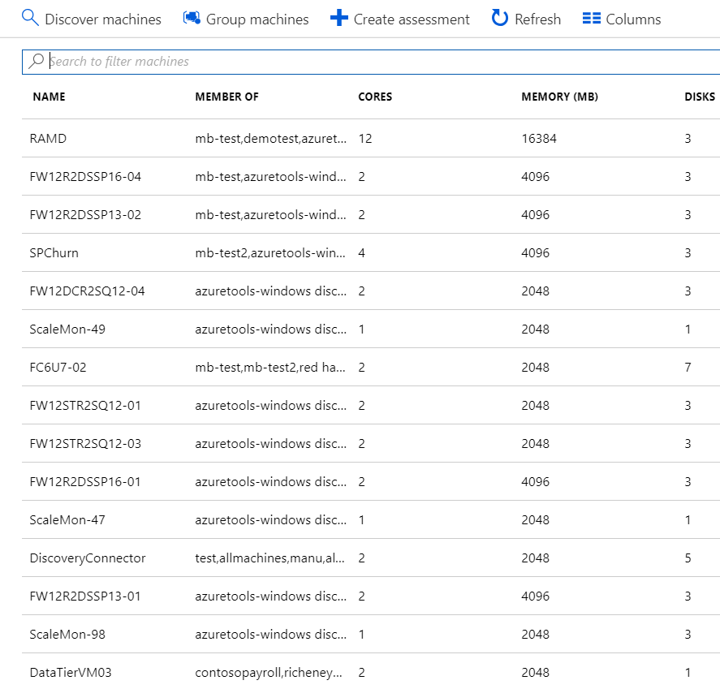
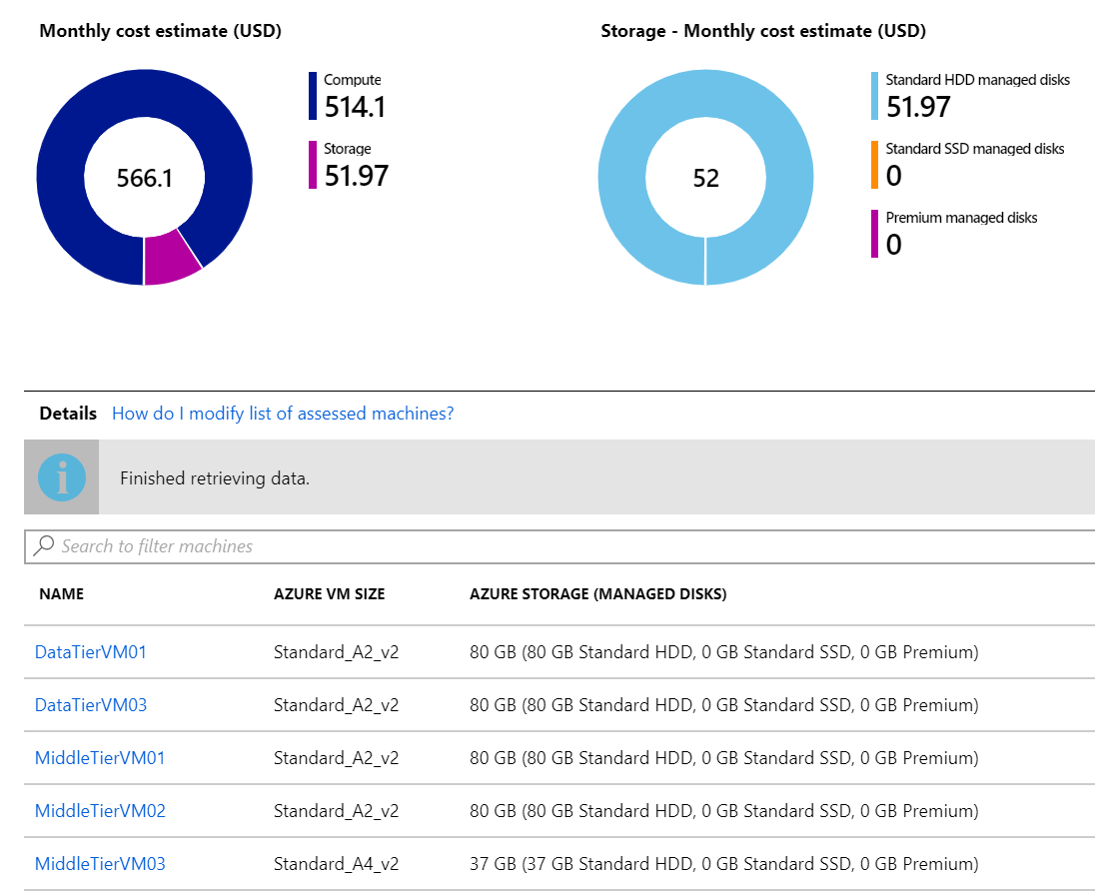
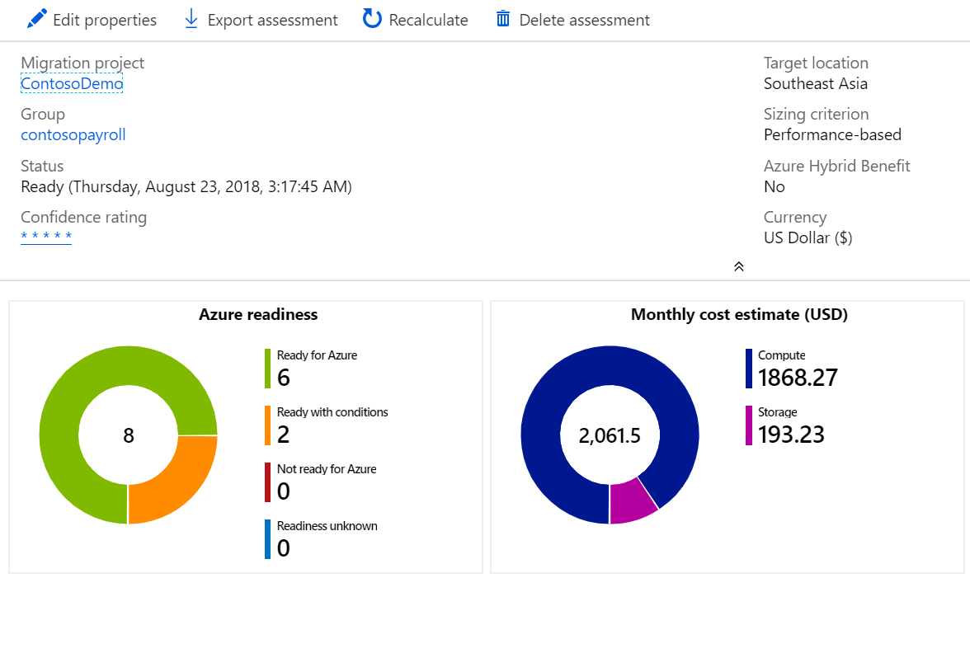
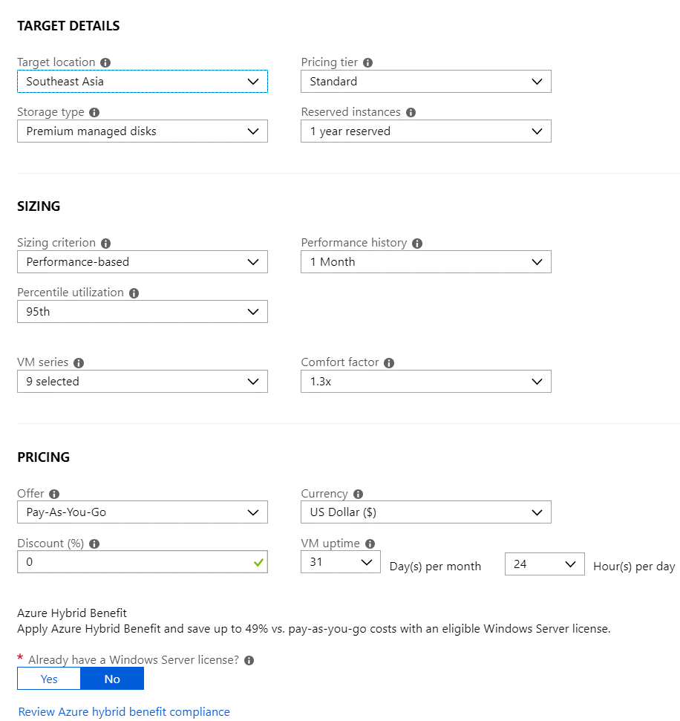
Azure Migrate for Discovery and Assessment
Agentless discovery
TCO calculation
Right-size and suitability
Azure platform

Slide 17

Migrate Windows Server 2008 32-bit and 64-bit to Azure
Azure Site Recovery

Slide 18

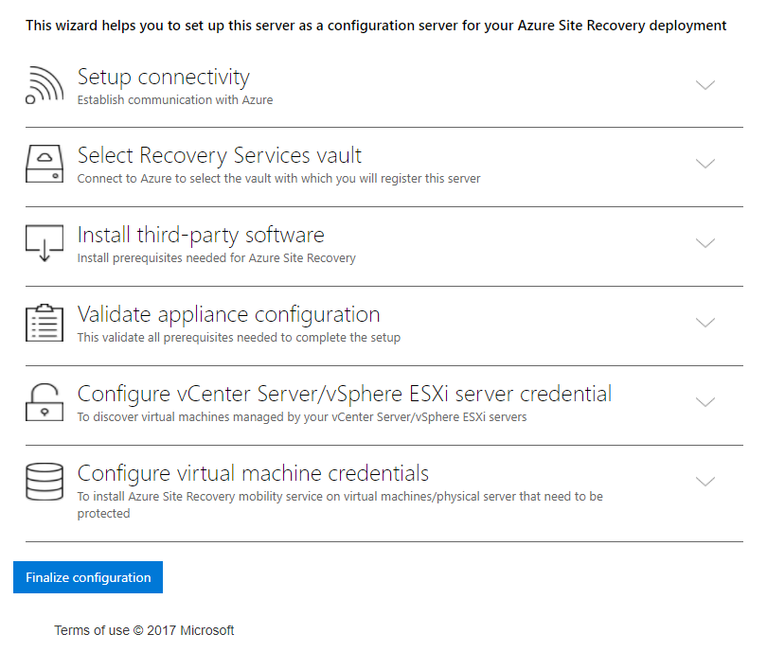
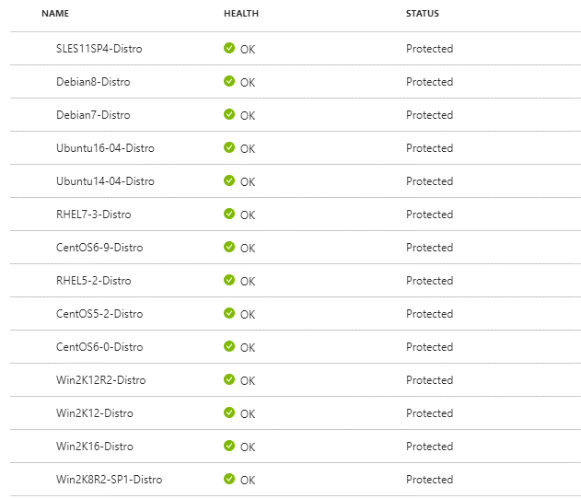

Azure Site Recovery for Server Migration
Easy to onboard
Broad coverage
UEFI support
2K8 32-bit support

